Slide 1
BUG REPORT
FCIS OS
TEAM 67

Slide 2
AGENDA
01
02
03
INTRODUCTION
ISSUE DESCRIPTION
POSSIBLE SOLUTION

Slide 3
01
INTRODUCTION

Slide 4
For example : the “ factorial” program need a 11 Working set size to avoid any page faults.
If it decreases, a page fault will occur.

Slide 5
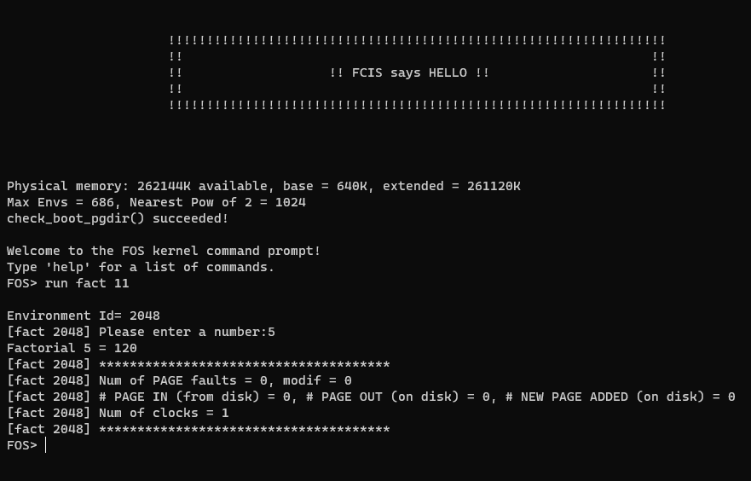
SCENARIO 1
Run factorial program with 11 working set size
No page fault

Slide 6
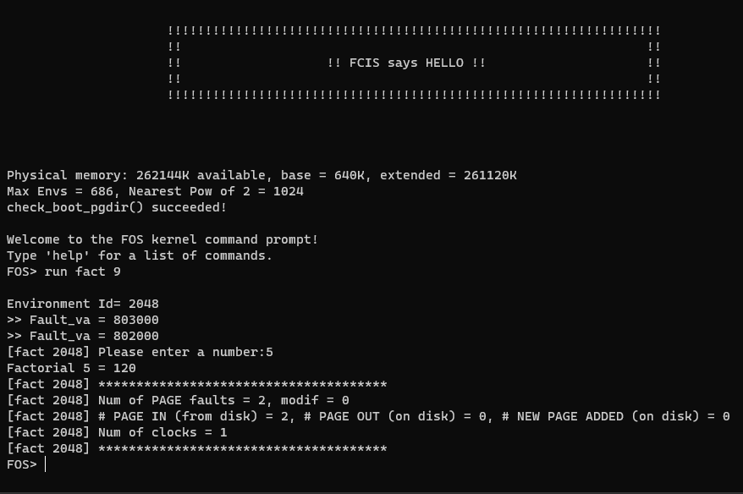
SCENARIO 2
Run factorial program with 9 working set size
Two page faults occurred

Slide 7
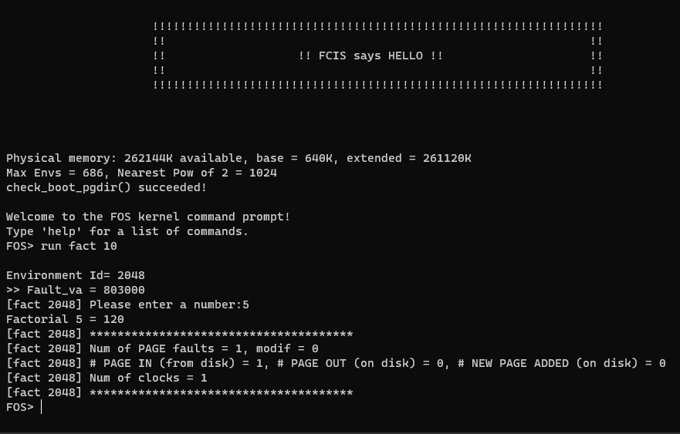
SCENARIO 3
Run factorial program with 10 working set size
one page fault occurred

Slide 8
02
ISSUE DESCRIPTION
Trap problem in trap.c

Slide 9
ISSUE
When more than three different factorial environments give the same faulted virtual address,
a trap occurs.

Slide 10
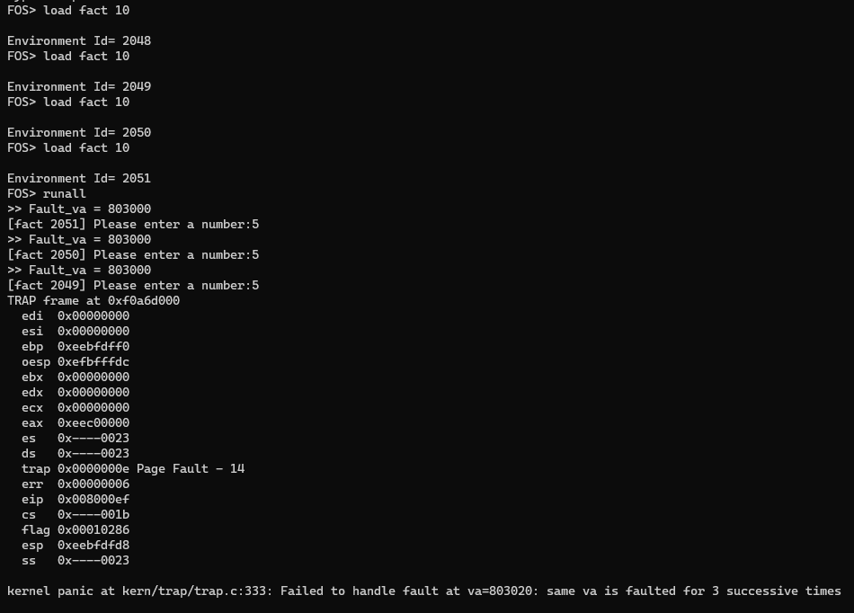
SCENARIO
Load more than three factorial programs all with 10 working set size .
Three different environments with the same faulted virtual address , A panic occurred , How ?

Slide 11
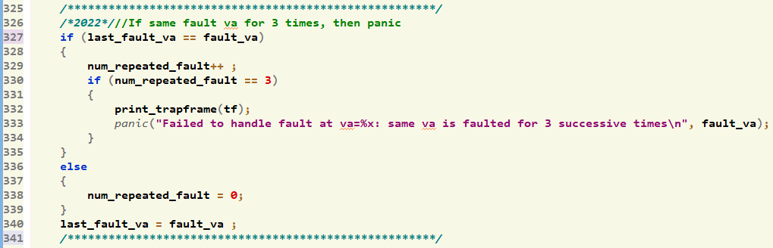
WHY HAPPENED ?
This condition verifies whether the same faulted address occurs three consecutive times, without considering whether it occurred within the same environment or not.

Slide 12
03
POSSIBLE SOLUTION

Slide 13
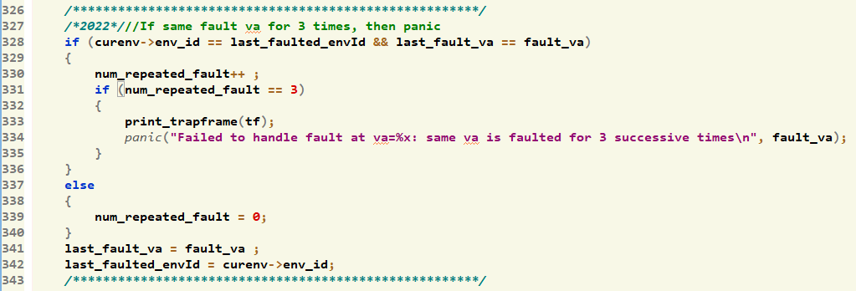
SOLUTION
We now verify whether the faulted address occurred within the same environment or not.

Slide 14
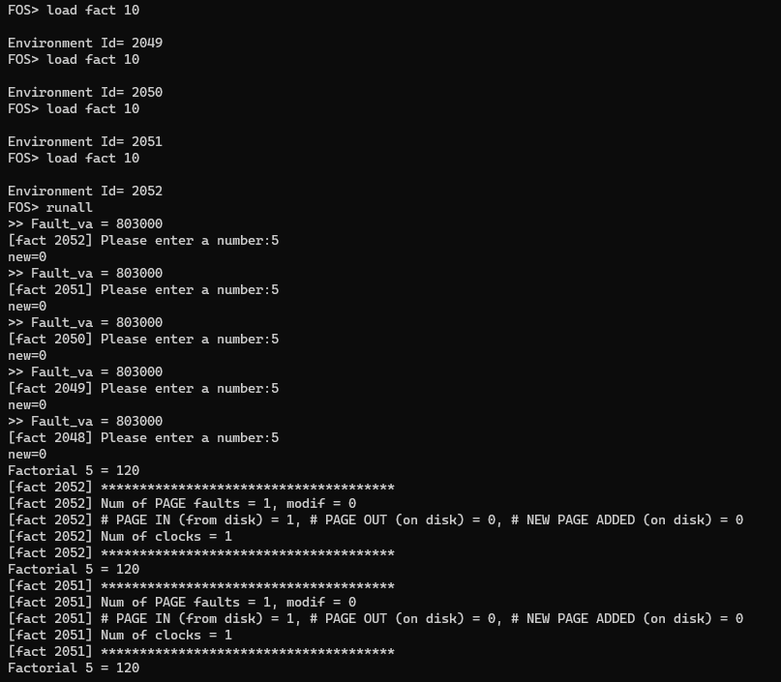
SOLUTION CONT…
Now it works !
Correct

Slide 15
DOCUMENTATION
FOS_BONUS_TEMPLATE

Slide 16
Thanks !

